Slide 1
The role of social information and referential uncertainty during cross-situational word learning
Kyle MacDonald
Developmental Brownbag
5/21/14
Notes:
Hello everyone. I know most of you, but for those who I haven’t met - my name is Kyle MacDonald and today I’m going to talk about some research that I’ve been working on during my first year at Stanford. I should mention that this is collaborative work with my advisor Mike Frank and a post-doc in my lab, Dan Yurovsky.

Slide 2
Notes:
children learn words remarkably fast. To do this, they have to solve an extensive list of inferential problems such as being able to interpret a speaker’s utterance as having communicative intent, extract individual words from that utterance, map that word to the correct object in the world, and retain that link over time.
Today I’m going to be focusing on the specific problem of how children learn concrete nouns and one of the fundamental componenents of this puzzle -- how children solve the problem of referential uncertainty.

Slide 3
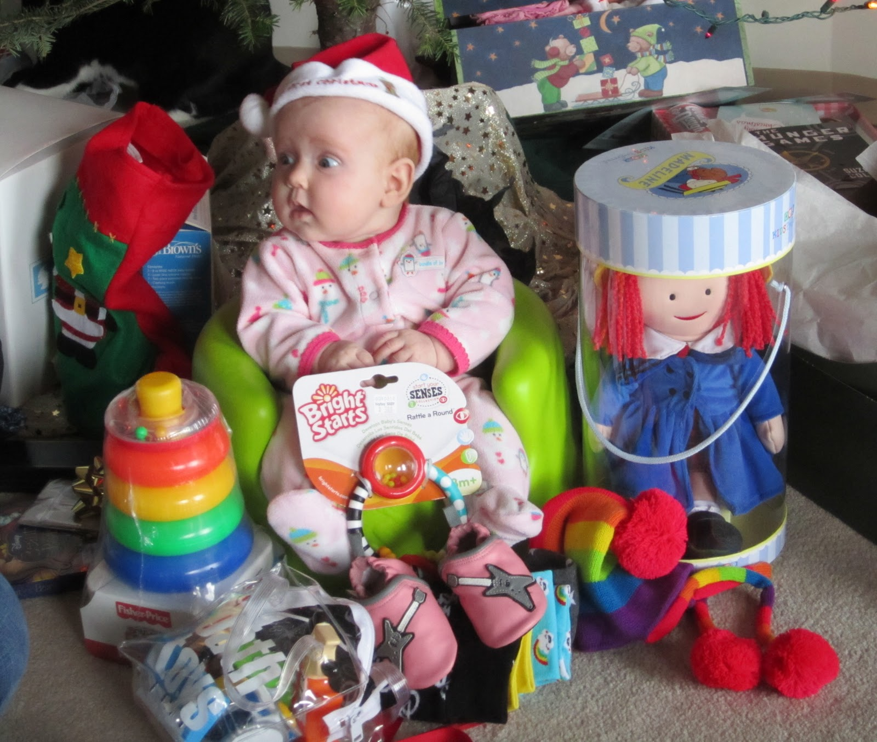
The problem of baby’s first Christmas
Dax?
Dax?
Dax?
Dax?
Quine (1960)
Notes:
Or what I’m going to call, “The problem of baby’s first Christmas.”
Imagine you are this child, surrounded by novel objects that you’ve only seen for a couple of minutes and you’re highly motivated to figure out the words for each object. Then mom says something like, “Hey! Do you like your new dax?” The problem here is that dax could refer to any of these toys, to some properties of the toys, or even nothing at all.
So without any additional information, it’s probably going to be difficult to figure out which of these exciting new toys is the dax. And given your uncertainty it might make sense to keep track of a couple of the toys and hope that more more cues to reference will come along later. Reducing uncertainty across multiple labeling events (or over time) has been called CROSS-SITUATIONAL LEARNING.
However…

Slide 4
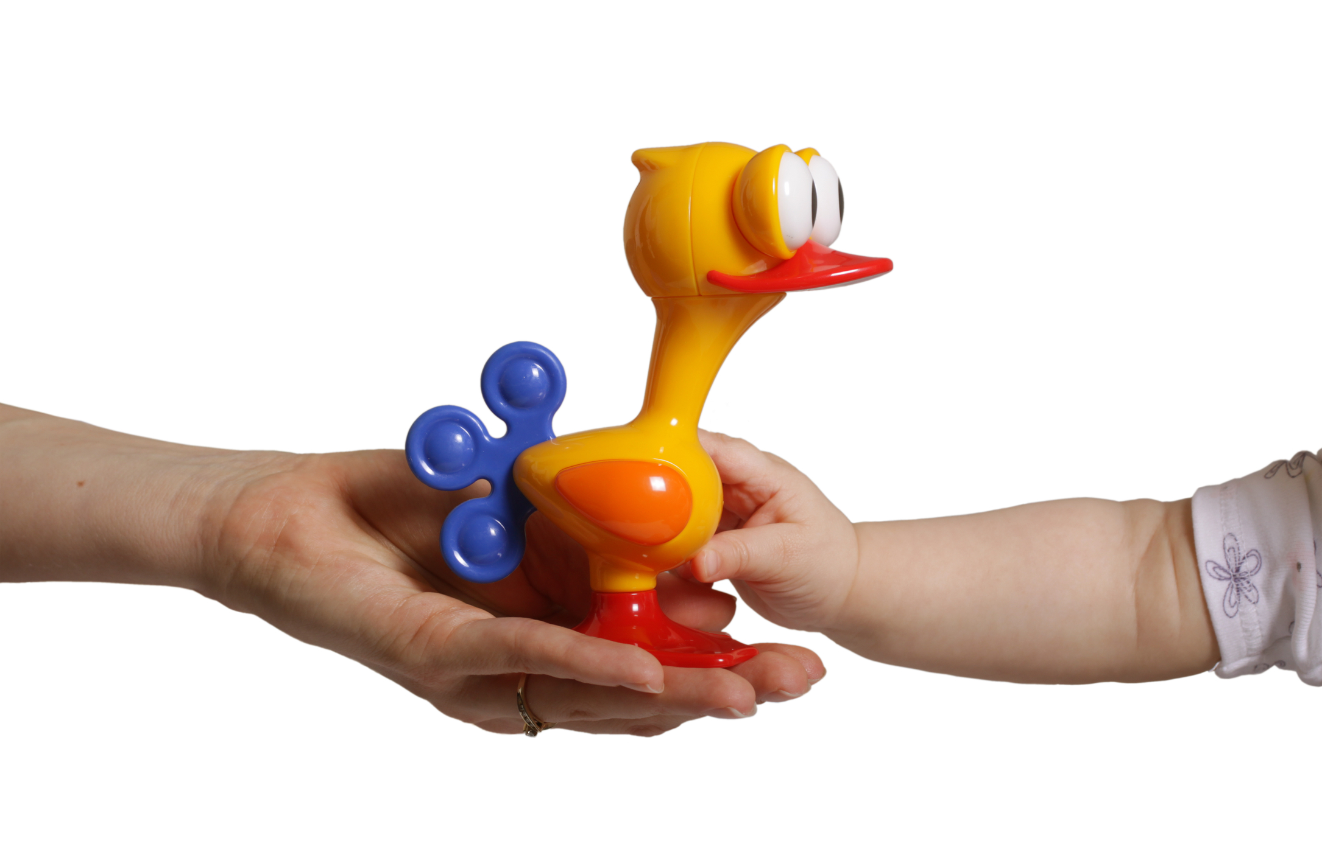
Dax?
Notes:
However, if mom hands you one particular toy and says, “Hey, do you like your new dax?” Then perhaps you can be more confident about what she’s talking about and maybe it’s not necessary to track the co-occurrence of dax and this thing or that thing.

Slide 5
Dax?
Dax?
Dax?
Dax?
Dax?
Notes:
Then, perhaps you can be more confident about what she’s talking about and maybe it’s not necessary to track the co-occurrence of dax and this thing or that thing.
In this talk, I explore how how the presence of social cues during labeling reduces uncertainty and changes cross-situational learning behavior.

Slide 6
Roadmap
Different ways to reduce referential uncertainty
Debate about the processes underlying cross-situational word learning
A novel, large-scale experiment and computational model
Notes:
First, I will discuss two different ways children might solve the problem of referential uncertainty.
Then, I will go into more detail about the processes that underlie both social and cross-situational learning in order to situate the current work within these debates
Finally, I will present data from a large-scale experiment with adults that suggests there is a tradeoff between uncertainty reduction and how learners’ track potential word meanings. I will also present a computational model that allows us to formalize our intuitions about how the presence of social information might influence learning.

Slide 7

Reducing uncertainty in-the-moment
Bloom (2002); Baldwin (1995); Tomasello (2009)
Notes:
Social-Pragmatic theories argue that children’s ability to understand a speaker’s communicative intent is foundational to word-learning. Once the child is capable of rapidly inferring a speaker’s communicative intent, the word to object mapping problem is simplified. This is because uncertainty is reduced in-the-moment by the presence of a speaker whose referential intent is revealed via social cues such as eye-gaze.
So similar to the earlier example this example the child’s learning task is simplified, and might look more like this, because there is another person providing additional cues to reference. However, this approach assumes that young children are capable of reading other’s intention via social cues and from young age. But are children capable of this sophisticated social cognition?

Slide 8
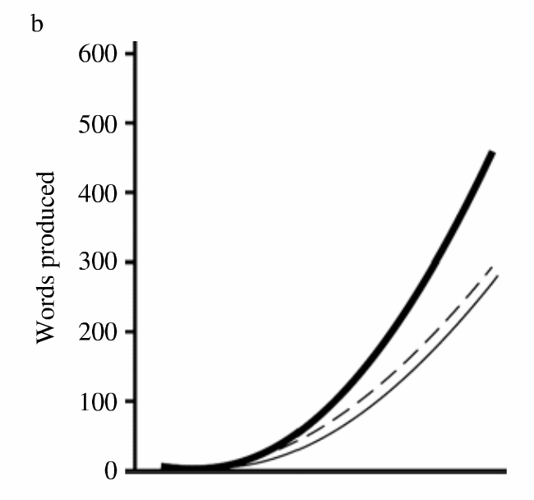


Reducing uncertainty in-the-moment
Baldwin (1991); Brooks & Meltzoff (2008)
Notes:
One particularly powerful demonstration of children’s sophisticated intention reading skills comes from a study conducted by Dare Baldwin. The experimental set up is simple. There is a child and an adult sitting across from each other at a table with 2 novel objects on it. Baldwin taught new labels for novel toys in 2 situations. In follow-in labeling, the experimenter looked at and labeled a toy at which infants were already looking. In discrepant labeling, the experimenter looked at and labeled a different toy than the one occupying infants' focus.
Children had no trouble making the mapping in the follow-in condition. Critically, in the discrepant labeling condition 16 to 19 month olds showed no evidence of making mapping errors, suggesting that they were using the adult’s eye gaze as a cue to her referential intent. This is strong evidence of children’s sophisticated intention reading, and it’s also important to note that this finding cannot be explained by simple associations between words and objects.
Importantly, children’s ability to use social information is not just limited to stripped-down experimental tasks.

Slide 9
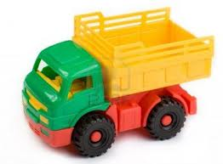

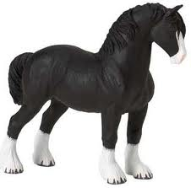
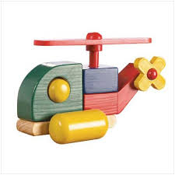
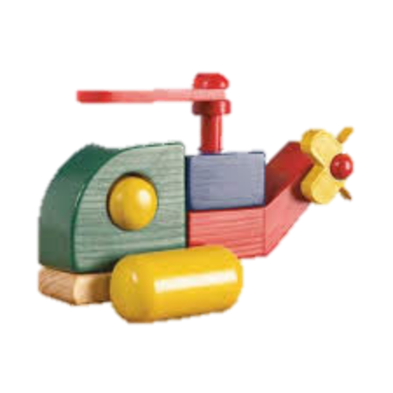
Reducing uncertainty over time
“Truck”
Truck
2 | 1 |  | 1
 | 1 | 1
“Ball”
Ball
“Truck”
Time
Notes:
One alternative approach is to reduce ambiguity over time by aggregating aggregating co-occurrence statistics of words and objects across individually ambiguous naming events. This proposal has been called cross-situational learning.
For example, while the word truck may occur with a truck and a ball in one situation, later on it may be heard without ball and with
other objects,. Over time the referent, truck, is likely to be the most frequently co-occurring object. Thus, at any given time, the child may not need to determine the referent—the child only needs to accumulate co-occurrence statistics to learn the mappings.
This proposal is preferred by many researchers because it doesn’t posit additional learning mechanisms beyond associative mechanisms that have been studied in depth are are better understood than constructs such as referential intent. But it does seem like tracking and updating co-occurrence information could be computationally challenging for early word learners.
Furthermore,

Slide 10
Reducing uncertainty over time
2 | 1 |  | 1
 | 1 | 1
Experimental work shows that adults and infants can learn novel words from co-occurrence information without additional cues to reference
Computational models suggest that cross-situational learning can be used to accurately infer the meanings of words from corpora and learn language-scale lexicons
Blythe et al. (2010); Frank et al. (2009); Smith & Yu (2008); Yu & Smith (2007)
Notes:
Adults (Yu & Smith, 2007) and infants (Smith & Yu, 2008) were exposed to small artificial lexica that contained cross-situational regularities across trials. Both groups successfully learned the word– object linkages from this alone, with adults showing evidence of learning even in highly ambiguous conditions. These results provide an important proof of concept, that statistical or associative learning may proceed without solving referential ambiguity in the moment via social cues.
Also, Computational models suggest that XSL can be used to accurately infer the meanings of words from small but realistic corpora of language use (Frank, Goodman, & Tenenbaum, 2009; Siskind, 1996; Yu, 2008; Yu, Ballard, & Aslin, 2005), and other researchers have shown mathematically that XSL can allow large, language-scale lexicons to be learned in the face of considerable referential uncertainty (Blythe, Smith, & Smith, 2010).
So there seems to be strong experimental and correlational work suggesting that social cues facilitate word learning. And there is experimental and modeling work to support the plausibility of cross-situational learning.

Slide 11
Integrative models of social and cross-situational learning
Spotlights for attention
Providing information about referential intent
Providing pedagogical information, i.e., information about the sampling process:
Yu and Ballard (2007); Frank et al. (2009); Shafto et al. (2012)
Notes:
Recent computational models attempt to formalize how social and statistical cues can be integrated to facilitate word-learning (Yu & Ballard, 2007; Frank, Goodman, & Tenenbaum, 2009). These models, however, treat social information in fundamentally different ways.
In Yu and Ballard (2007) Unified Model, social information, such as eye gaze or prosody, is characterized as a ”spotlight” that directs the child’s attention to objects in the visual scene. In this account, social cues are considered, but intention reading is secondary to attention and saliency. Put another way, social cue simply adds weights to the words and objects that allow statistical learning to operate more effectively.
(Frank et al., 2009) propose an Intentional model that characterizes social information as providing evidence of a speaker’s referential intent, which in turn facilitates word-learning. This model assumes that the relationship between words and objects is mediated by the speaker’s goals to refer to some object. By making inferences about a speaker’s referential intent, the model is able to simultaneously solve both the social-cognitive and mapping inference problems inherent to word-learning.
Providing information about the sampling process of exemplars. In Xu and Tenebaum’s experiment they showed that adults and children generalized more conservatively in the former context; that is, they restricted the label to just those objects most similar to the labeled examples when the exemplars were chosen by a knowledgeable teacher, but not when chosen by the learners themselves. Xu and Tenebaum don’t frame their task as manipulating social cues to reference, but it could be thought of this way. This brings up a novel way to think about social cues to reference – as pedagogical in nature.
Researchers also

Slide 12
Roadmap
Different ways to reduce referential uncertainty
Debates about the processes underlying cross-situational word learning
A novel, large-scale experiment and computational model
Notes:
But before I get to that work, I want to shift focus to talk briefly about two debates over the processes underlying social and cross-situational learning.

Slide 13
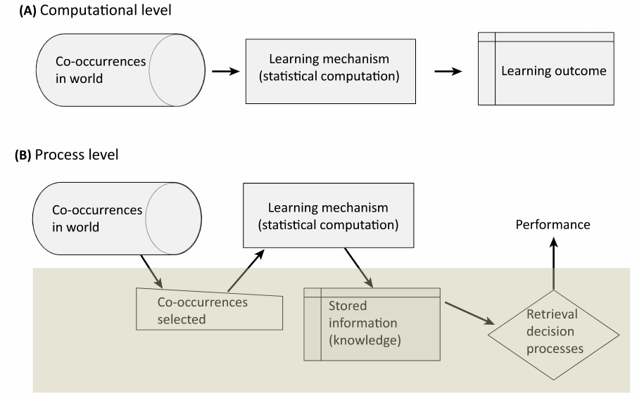
Smith, Suanda & Yu (2014)

Slide 14
Smith, Suanda & Yu (2014)

Slide 15
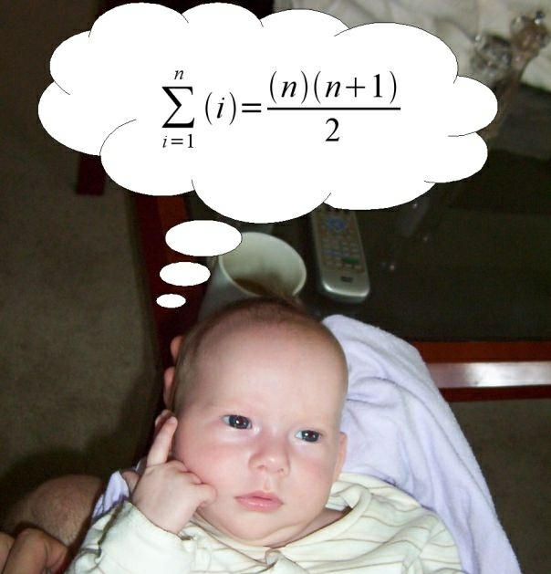
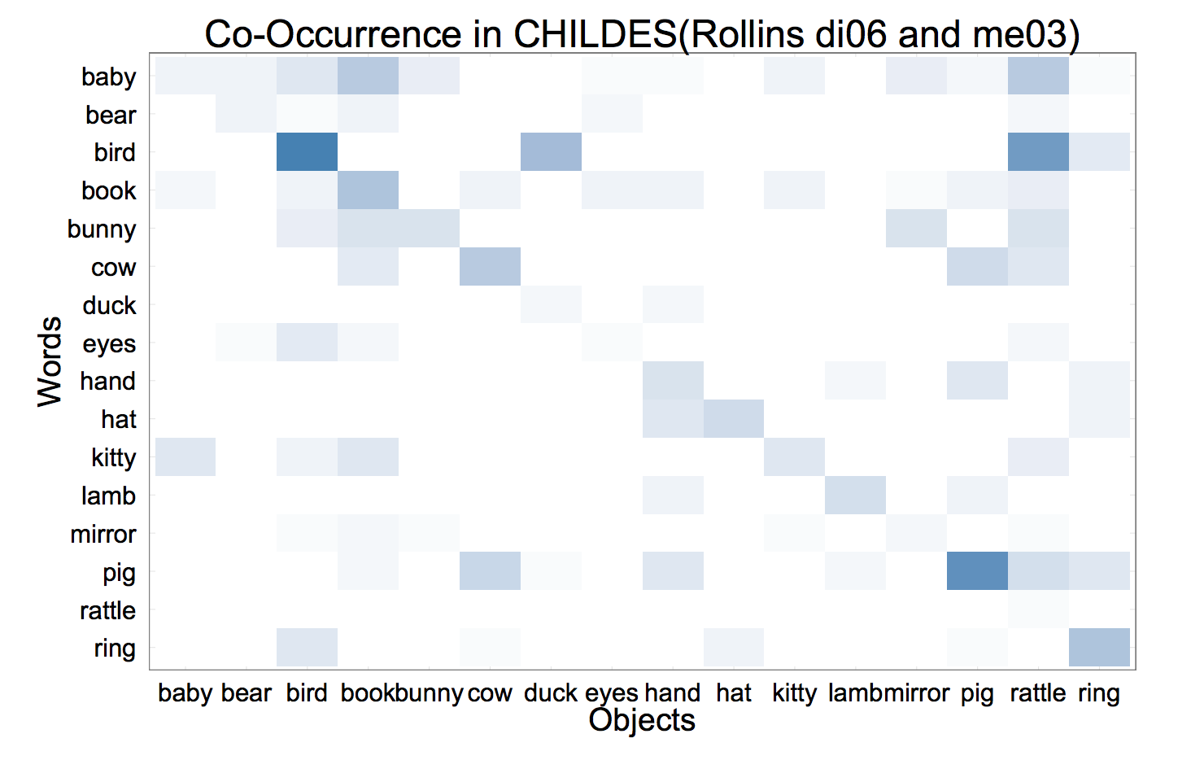

Single-hypothesis tracker
Co-occurrence tracker
BALL
Notes:
However, there is considerable debate at the “process level” as to exactly how cross-situational information is stored and used during retrieval. I will lay out two proposals.
The basic debate is whether learners are creating a co-occurrence matrix, tracking information about multiple alternatives OR tracking a single candidate hypothesis

Slide 16
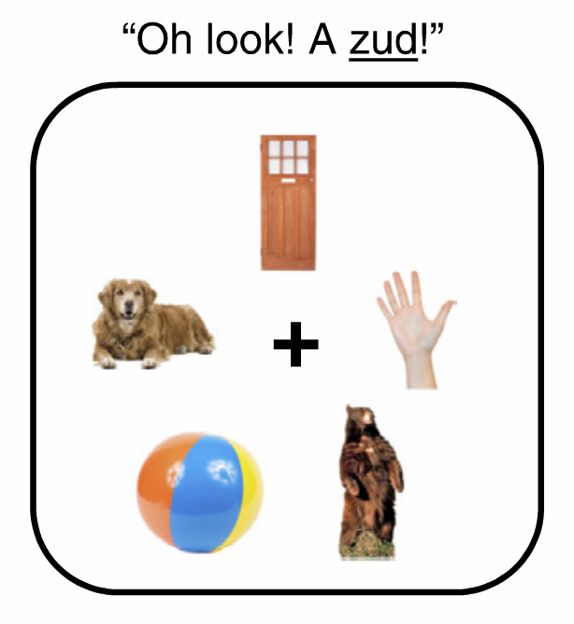
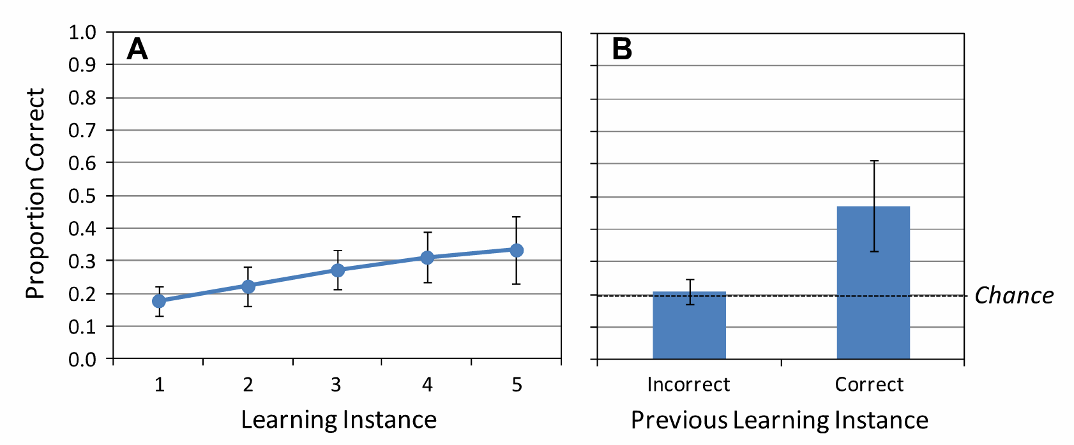
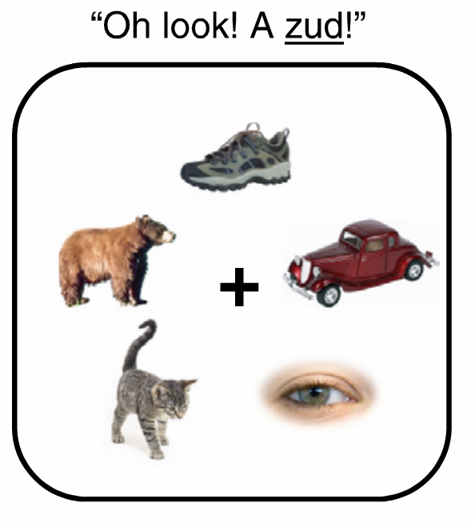
BALL
Trueswell, Medina, Hafri & Gleitman, (2013)
Notes:
Learning is the product of a one-trial procedure in which a single candidate hypothesis is tracked over time
some evidence that ADULTS in their task don’t seem to be tracking multiple co-occurrences

Slide 17




Exposure Trial
Grink
Same
Switch
Test
Trial
Yurovsky & Frank (under review)

Slide 18


Slide 19


Exposure
Test
0
1
3
7
Number of Intervening Words

Slide 20
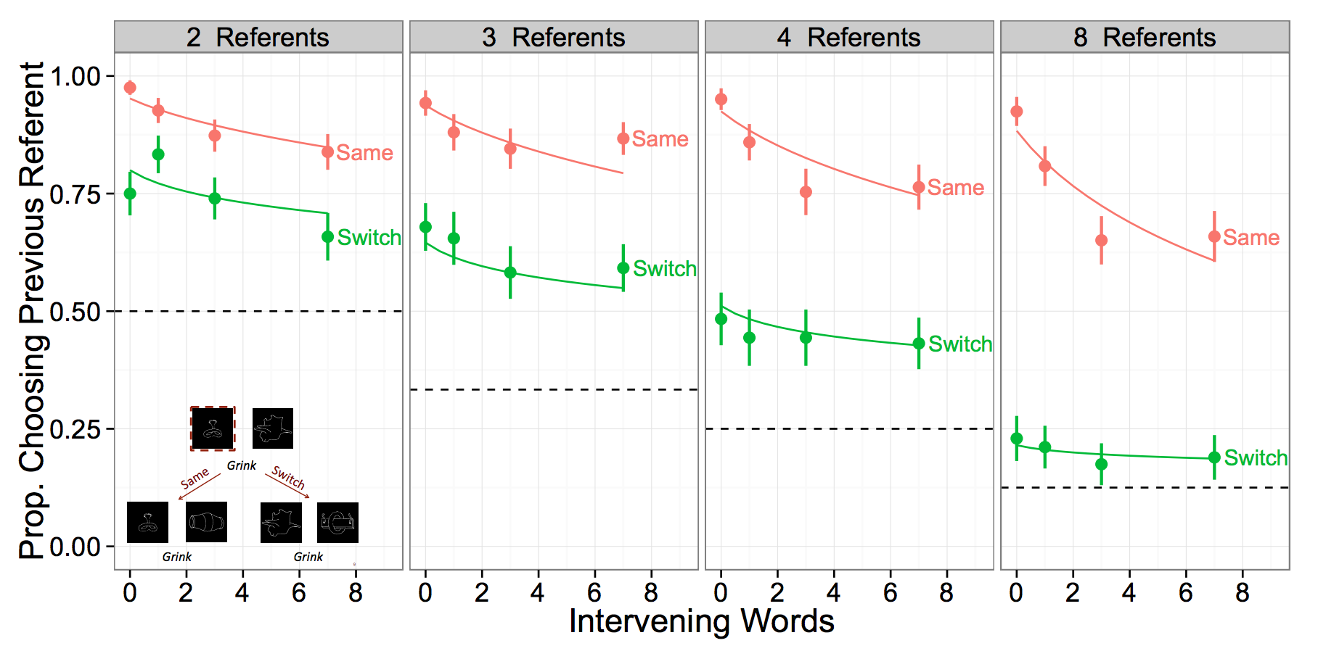
Notes:
Main point from Dan’s work → memory demands matter to representation

Slide 21
Adults and children show evidence of tracking a strong candidate hypothesis AND multiple alternative hypotheses even in highly complex learning situations
2 | 1
 | 1
BALL
Yurovsky & Frank (under review)
Notes:
Place these two learning strategies on a continuum and suggest that the behavior you show is influenced by attention and memory demands

Slide 22
Roadmap
Different ways to reduce referential uncertainty
Debates about the processes underlying cross-situational word learning
A novel, large-scale experiment and computational model
Notes:
I’m going to walk through all 4 factors that we manipulated: social, trial type, number of pics, delay between exposures

Slide 23

Including social information
“You will meet a speaker named Tina, who
will look at some objects and talk about them.”

Slide 24
Non-social exposure trials
Notes:
Tina always looked straight ahead

Slide 25

Social exposure trials
Notes:
We chose to use eye gaze because it was easy to manipulate and incorporate in the xsl task. We included arrows because piloting tasks showed that participants were struggling to figure out which object Tina was looking at. I don’t want to make any claims about eye-gaze specifically, we just used it to manipulate referential uncertainty.

Slide 26
All test trials were “non-social”

Slide 27


Slide 28
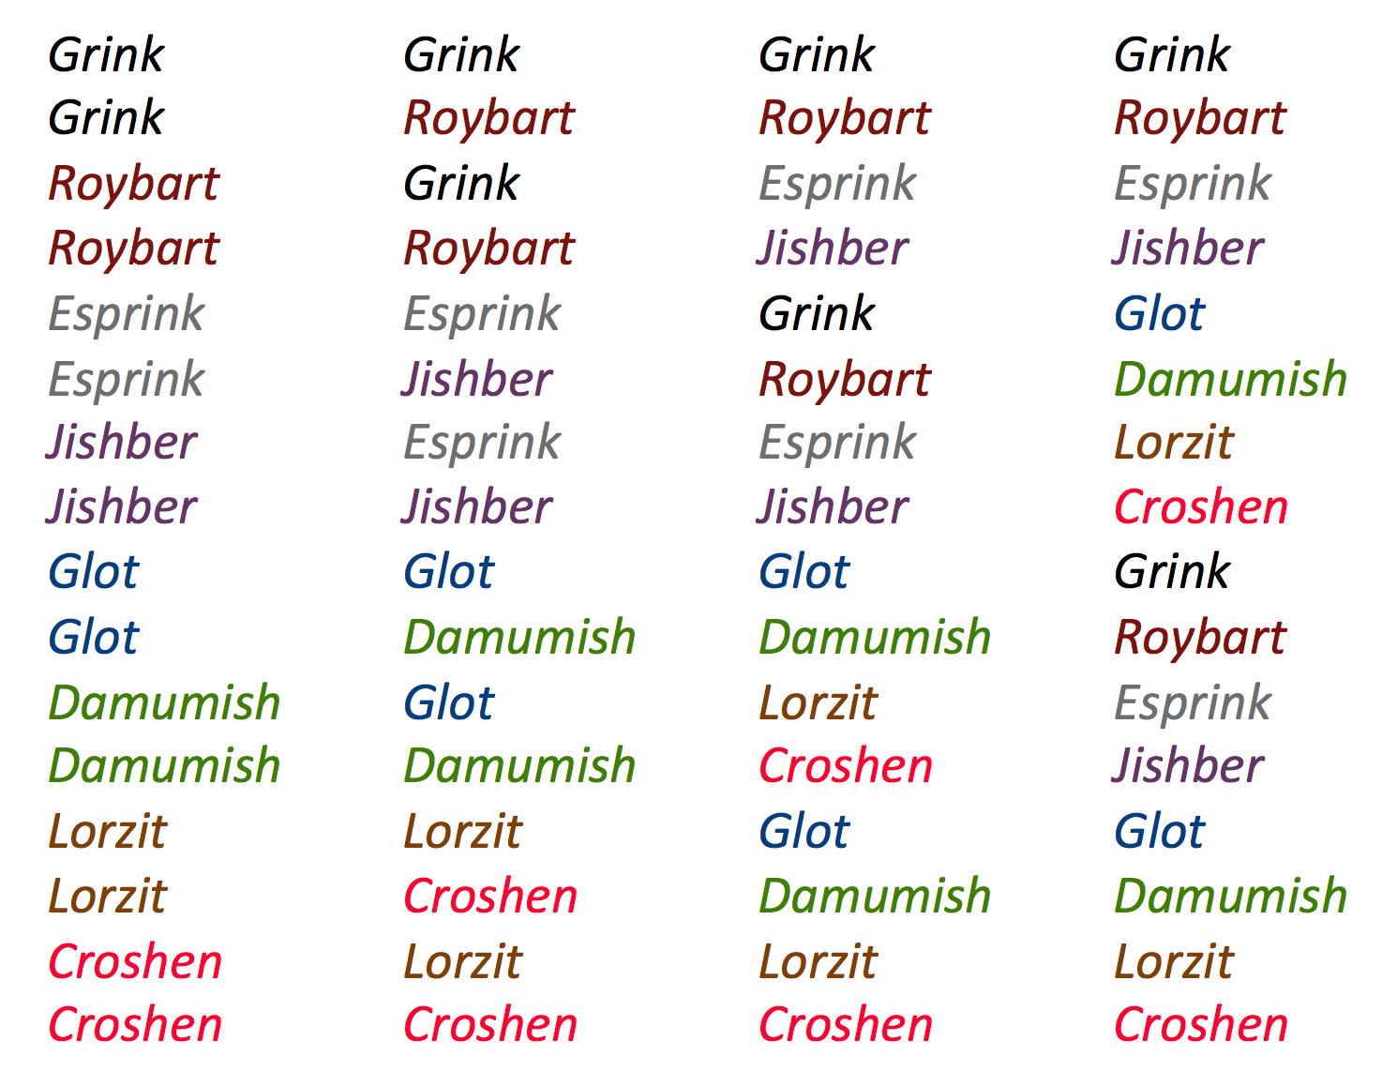
Zero
One
Three
Seven
Notes:
----- Meeting Notes (5/13/14 14:12) -----
add arrows
explicit about this, point out things on plot

Slide 29
Large-scale experiment manipulating attention and memory demands in a cross-situational learning task
1808 participants on Amazon Mechanical Turk. Restricted to US IP addresses and > 95% approval rate
Each subject was exposed to 8 different novel words via one exposure trial and was tested once
Same/Switch trials is a within-subject manipulation
The presence of social information, number of referents, and number of intervening trials were all between-subject manipulations
Notes:
Novel words were 1-3 syllable pseudowords obeying the rules of English phonotactics
Novel images taken from Kanwisher, Woods, Iacoboni & Mazziotta (1997)
Now I’ll walk through the behavioral results

Slide 30
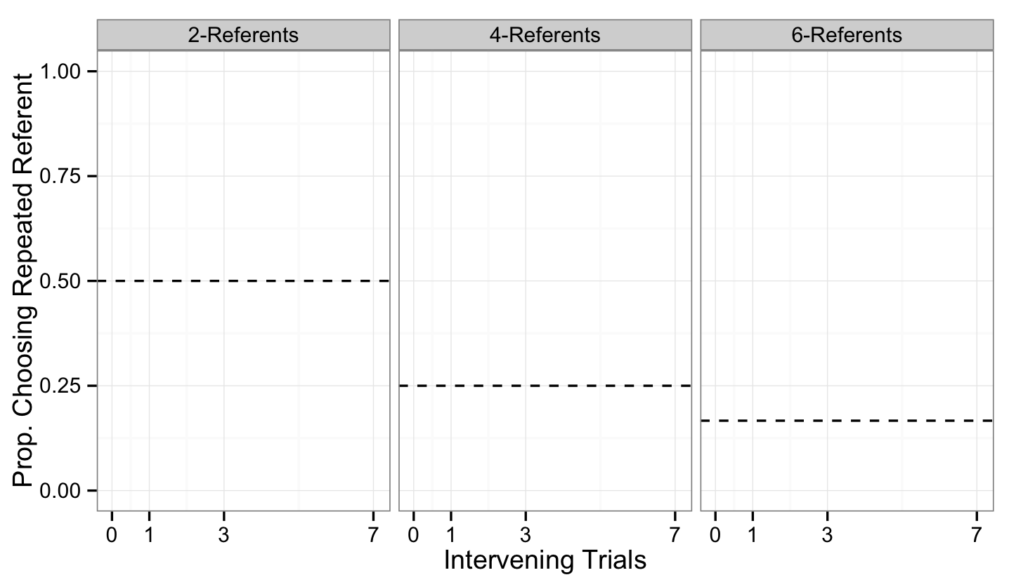
Notes:
First, I want to orient you to the graphs that I will show. Here we are plotting proportion choosing the repeated referent as a function of the number of intervening trials. The panels are different number of referents on exposure. Social points and lines will be blue and non-social will be red. Same trials are plotted with a solid line and switch with a dashed line. Here’s chance lines 1/number of referents.
And all error bars are 95% confidence intervals

Slide 31
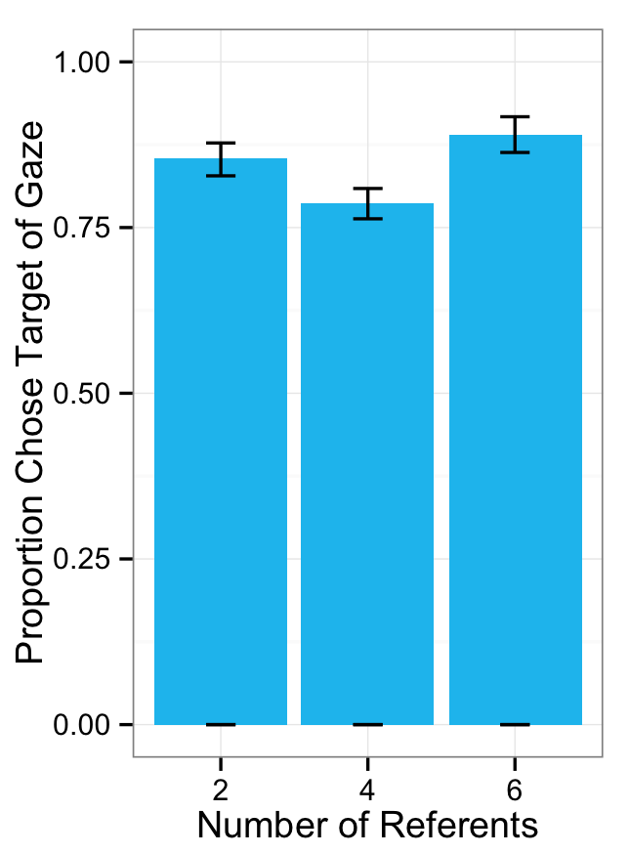
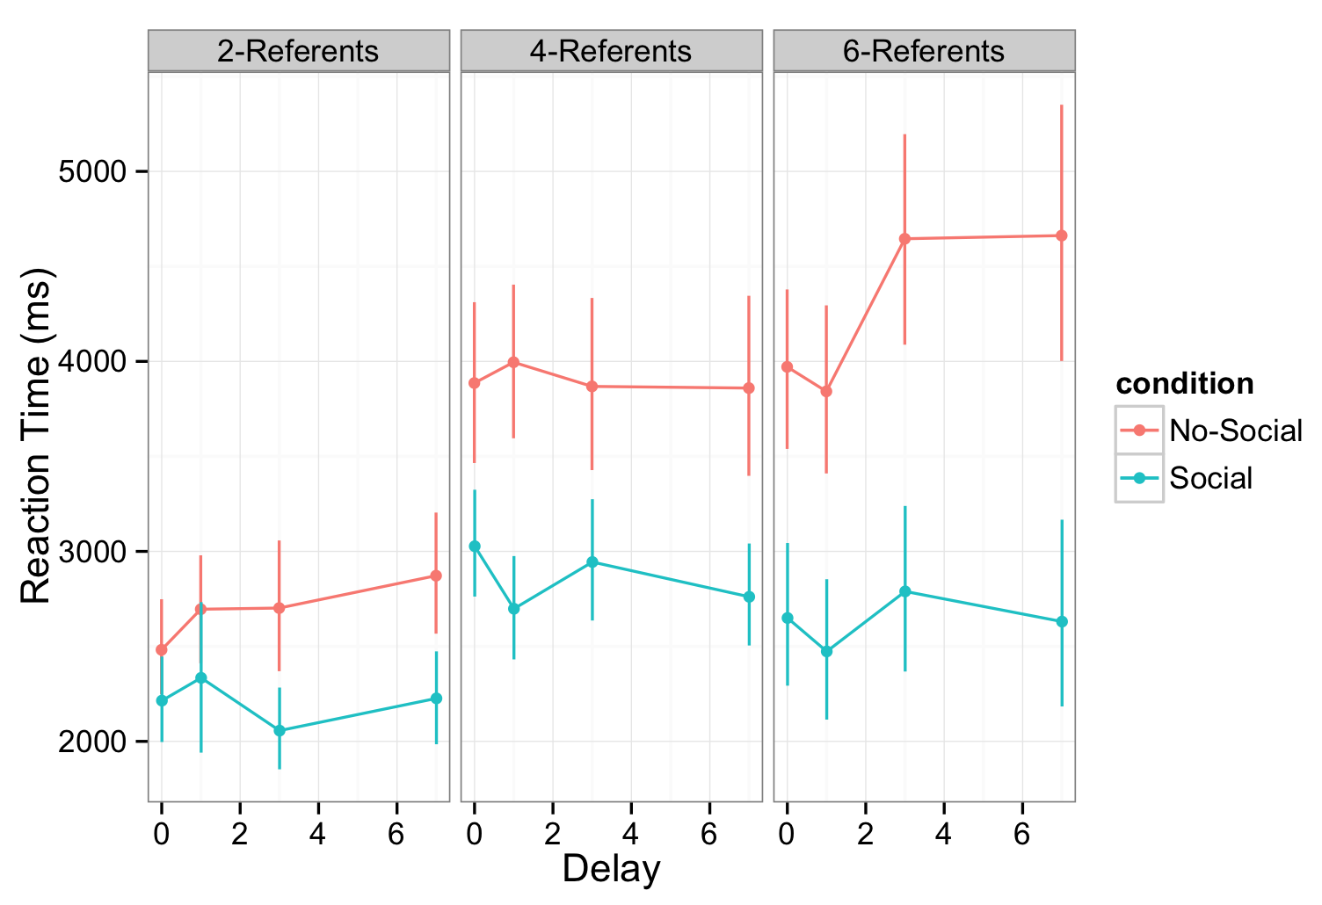
Participants reliably chose the target of eye gaze on exposure trials and took longer in the Non-social condition
Notes:
Manipulation check
----- Meeting Notes (5/13/14 14:12) -----
use sigma to predict
more time to talk about experiment and walk carefully through the data
key questions, one or two previous studies, cut stuff from the background.
return to baby christmas --> highlight broad overarching question
keep things in the background --> return to things int he background
how to better explain the model --> semantic glosses --> use short word instead -->
end of model --> bring back the parameters in lay terms and how data does or does not reflect --> setting up the model to cut the background
hold background slides
demo of the experiment would be helpful --> switch and same on the same slide
not a word on the screen --> put word on there
intervening trials slide confusing --> arrows to the target

Slide 32
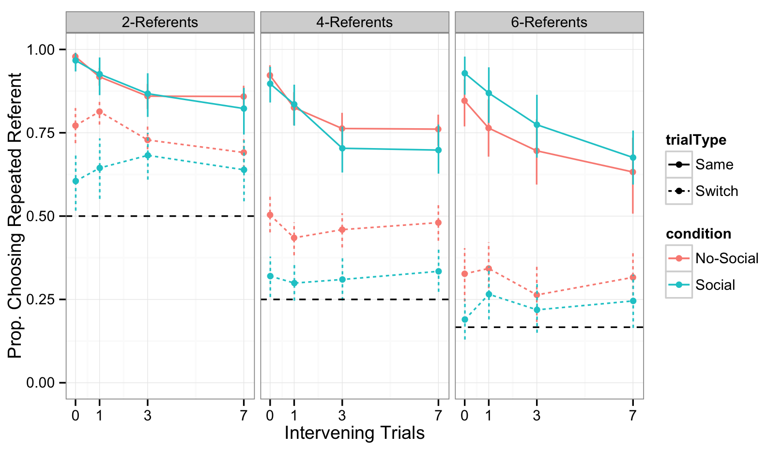
Accuracy data
Notes:
----- Meeting Notes (5/13/14 14:12) -----
modify model parameters -->

Slide 33
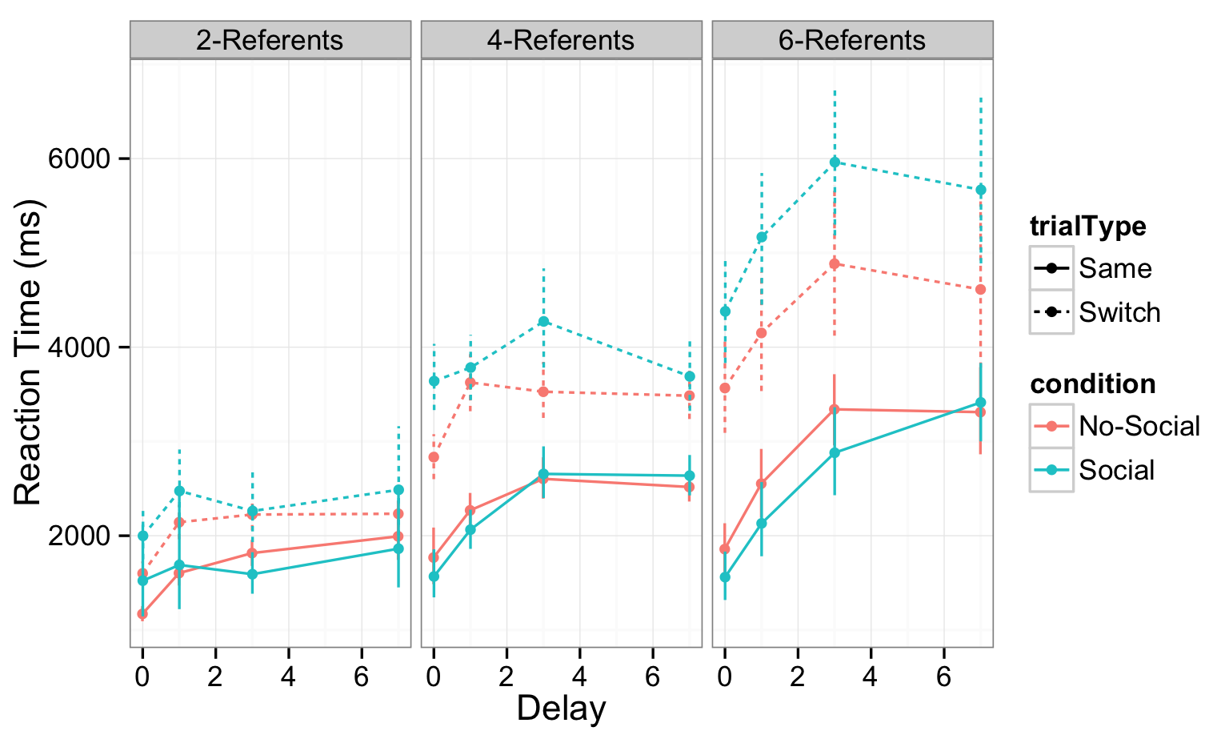
Switch trials take longer than Same trials and Social-Switch trials take the longest

Slide 34
Roadmap
Different approaches to solving the problem of referential uncertainty during word learning
Debates about the processes underlying social and cross-situational uncertainty reduction
A novel, large-scale experiment and computational model

Slide 35
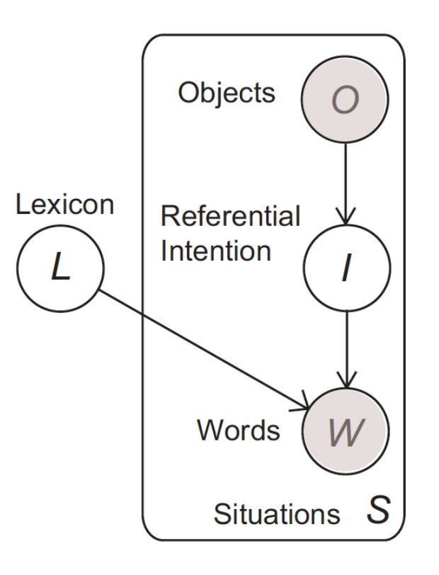
Computational-level model with cognitive constraints
σ → inferring referential intention
ϒ → strength of initial encoding
λ → rate of memory decay
Frank, Goodman & Tenenbaum (2009); Yurovsky & Frank (under review)
Notes:
In this framework, the learner observes a set of situations S with the goal of determining the lexicon of word-object mappings L that produced them P(L|S). Each of these situations consists of two observed variables: objects (O) and words (W). There’s also two unobserved variablse: intention (I) of the speaker and the learner’s task is to infer the lexicon with
Then we add general cognitive constraints, sigma which captures the inference people make about referential intention of the speaker’s utterance, gamma which captures the strength of the initial encoding of each object, and lambda which captures the rate of memory decay over the various delay conditions.
A key parameter in this model is sigma…

Slide 36
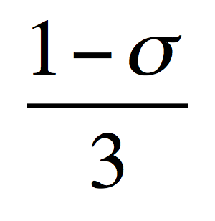

Inferring the referential intention
Notes:
The idea here is that in an ambiguous learning context the learner makes one selection and decides how much belief to allocate across the referents on exposure

Slide 37
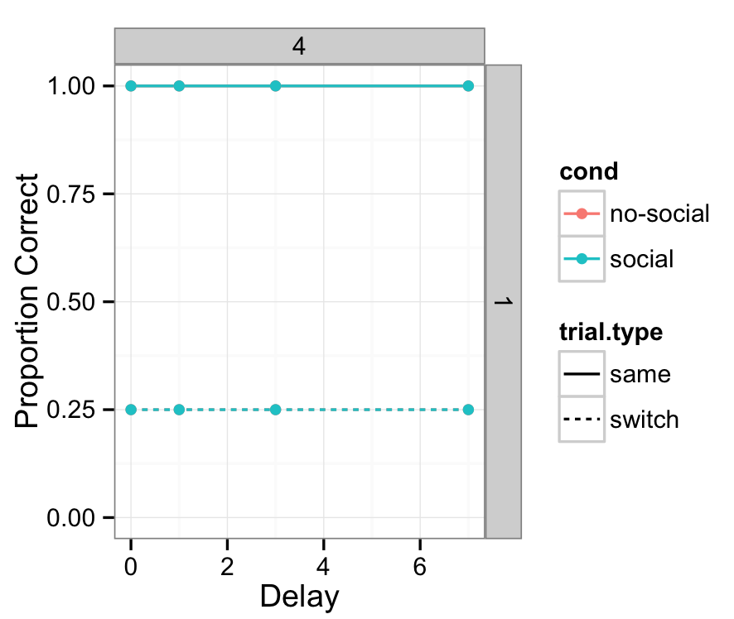
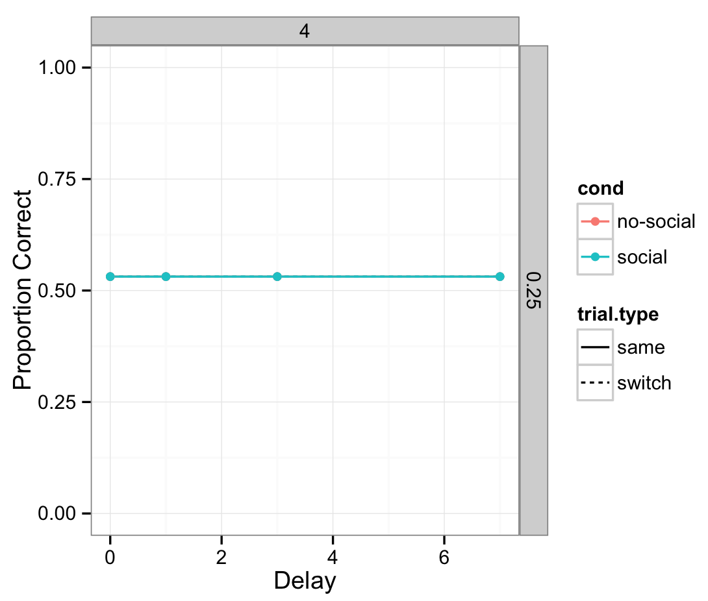
Using this model, we can simulate the optimal single and multiple hypothesis trackers
ϒ = 1.5
λ = 0
1
σ = 1
σ =
# pics

Slide 38
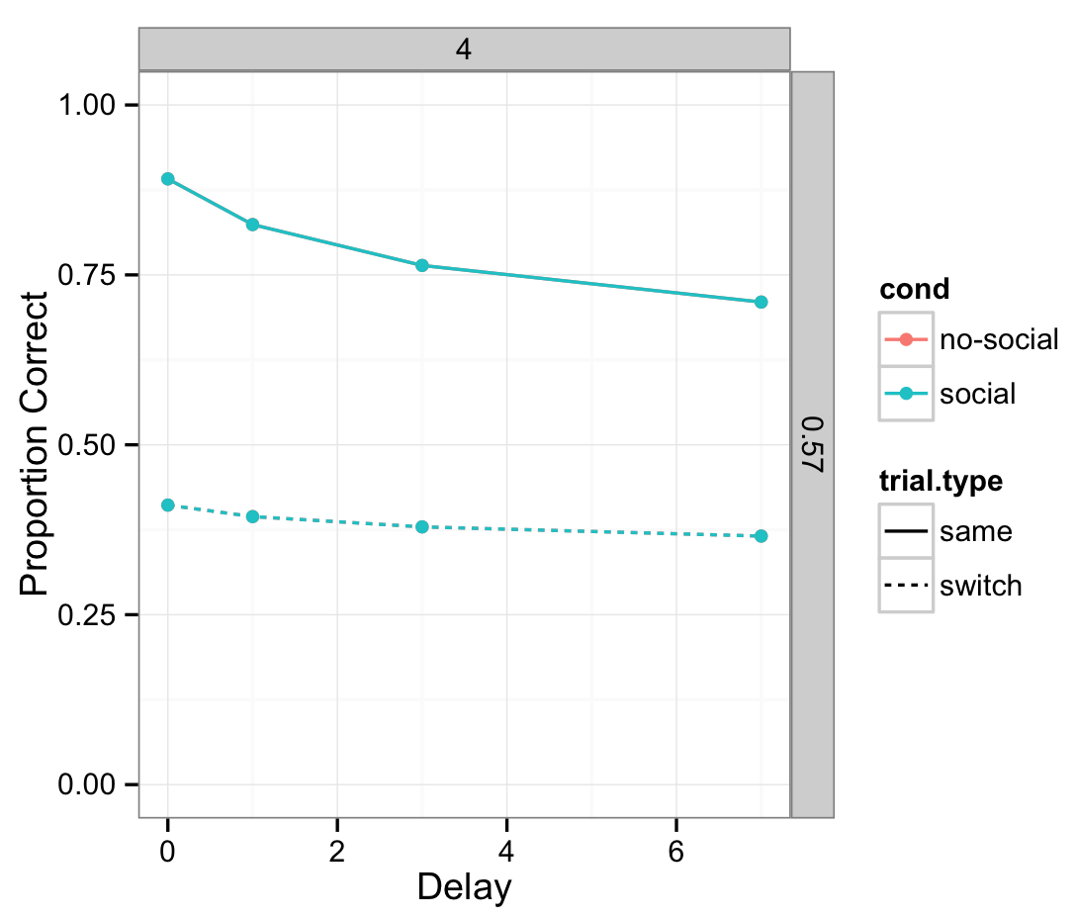
Adding intention and memory
σ = 0.57
ϒ = 1.5
λ = 0.15

Slide 39
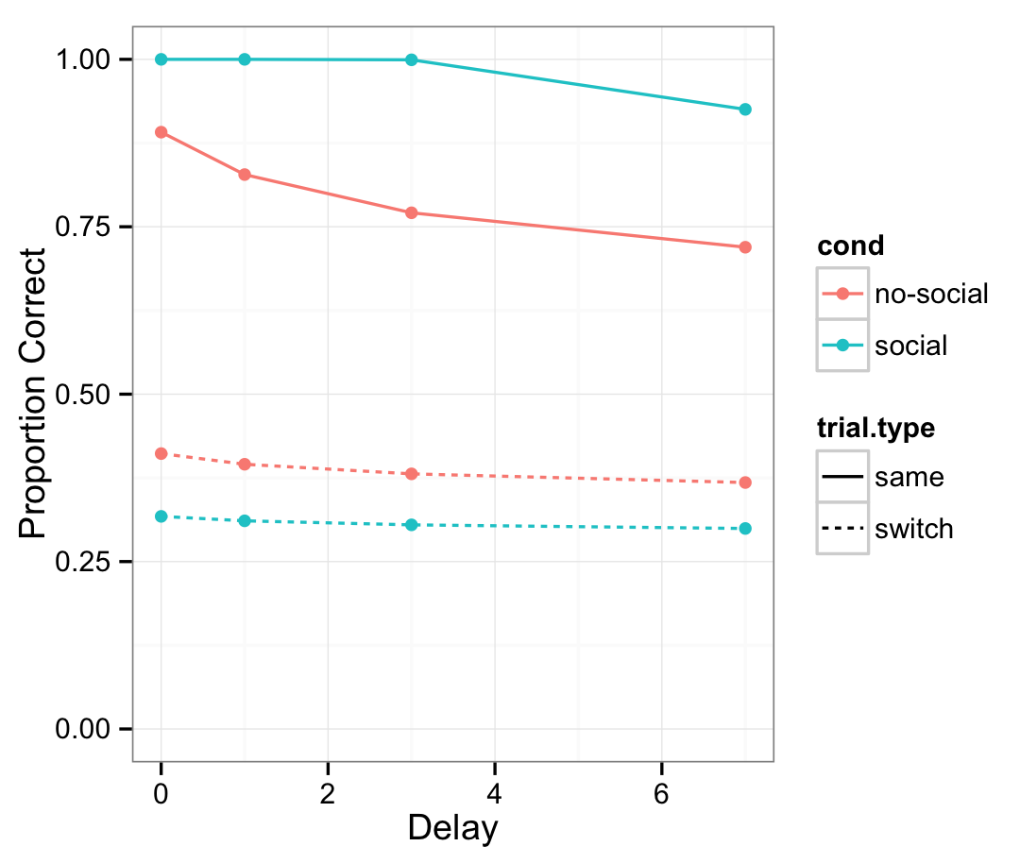
Is social information a boost to sigma?
σ = 0.57
ϒ = 1.5
λ = 0.15
Notes:
use as a tool to make predictions about what social information. is social information doing x, y, and z? interactions?

Slide 40
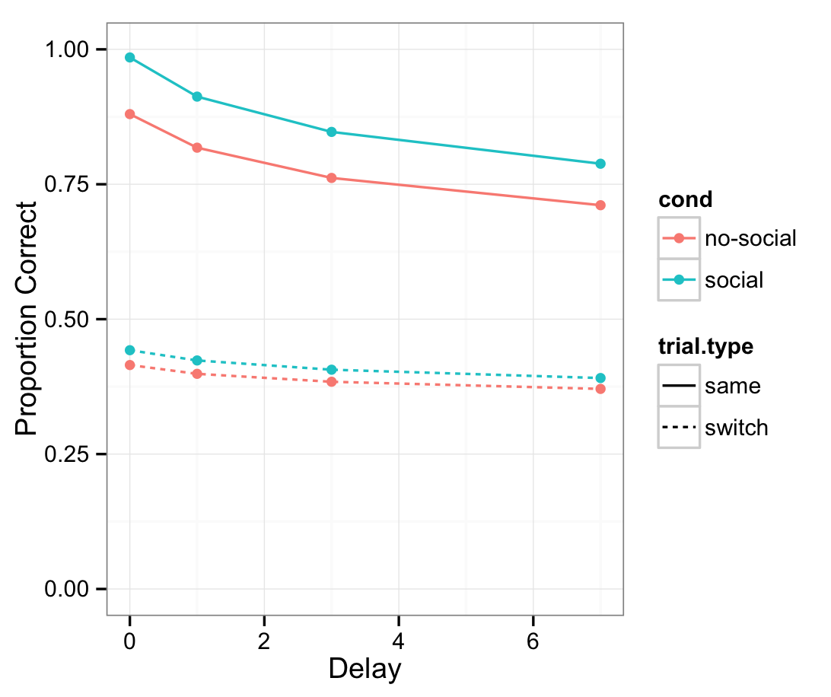
Is social information a boost to gamma?
σ = 0.57
ϒ = 1.5
λ = 0.15

Slide 41
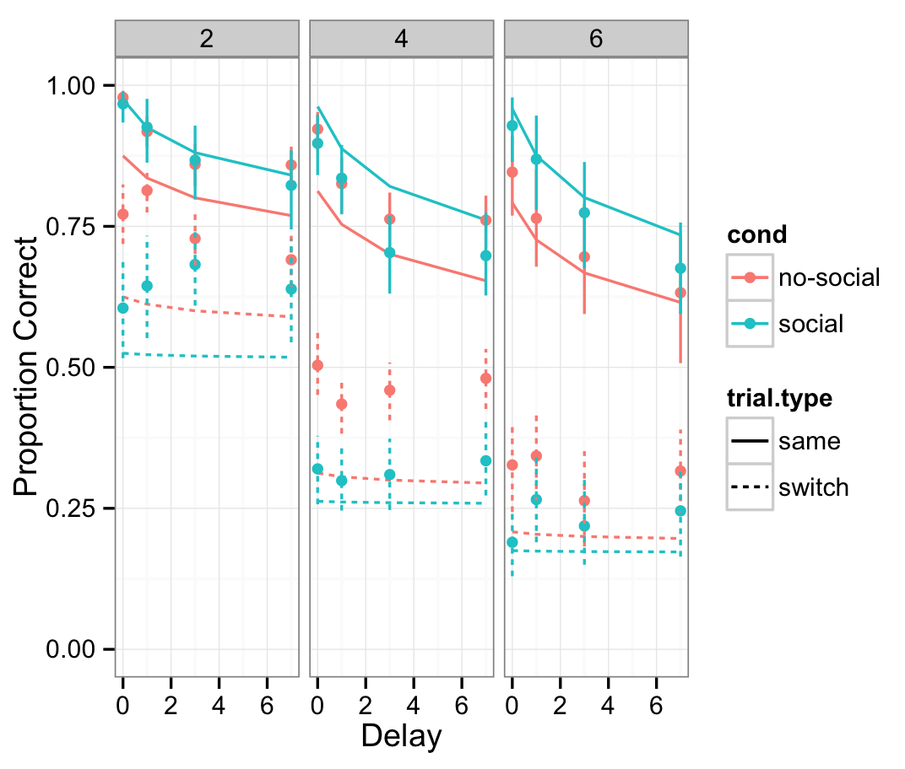
Eye-gaze as a “social boost” does not capture all the complexity in the human data
Notes:
Not able to capture the social boost to same trials AND the cost to same. Also not capturing the infraction with number of referents

Slide 42
Conclusions
Tradeoff between reducing referential uncertainty and tracking alternatives
The impact of social cues varies depending on attention and memory demands
Even at a higher level of certainty – i.e., with a social cue – learners still tracked multiple alternatives

Slide 43
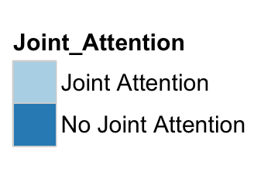
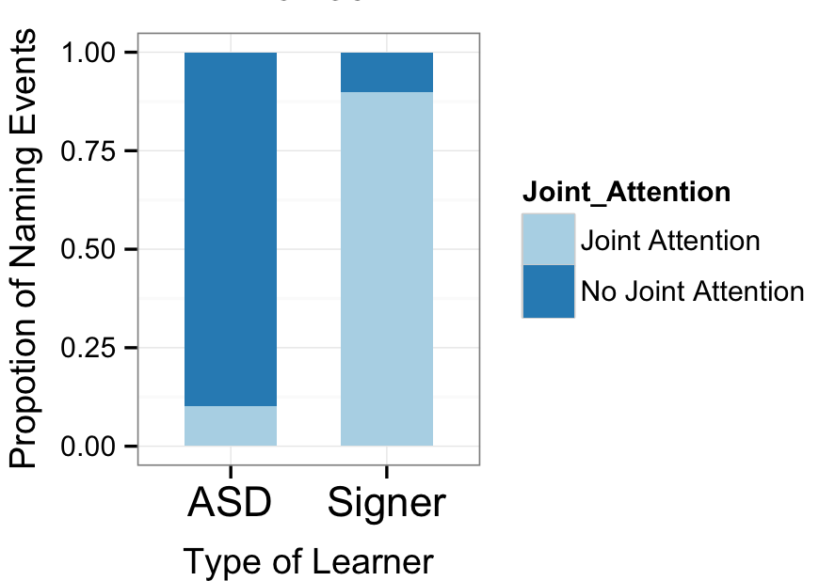
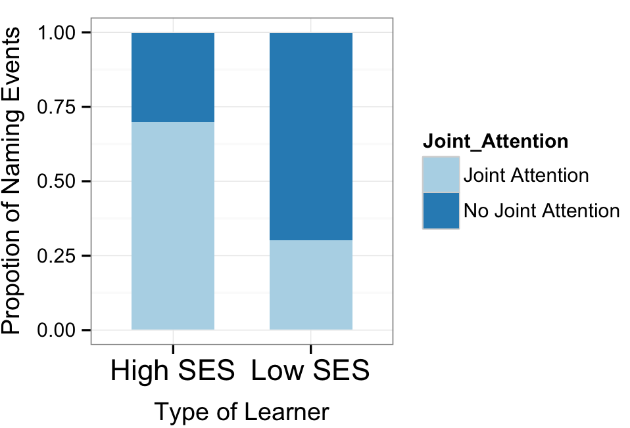
Learners might experience a different proportion of their naming events under uncertainty

Slide 44
“Learning” behavior may look different at different levels of uncertainty
BALL

Slide 45
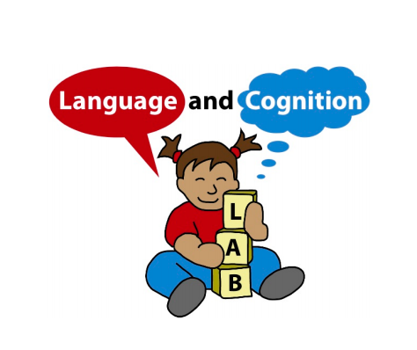
Acknowledgements
Michael Frank
Dan Yurovsky
Frank Lab
Markman Lab
Devostuds
First-year cohort
Thank you for your attention
Notes:
----- Meeting Notes (5/13/14 14:12) -----
Notes:

Slide 46
Statistical learning at scale
These differences may make
contenders for the label’s referent more memorable
across trials, and they may limit the number of
contenders – even when not clearly indicating the
correct one.
The accessibility of (potentially misleading)
social cues may also differ between the views.
For instance, mother’s gaze does not reliably predict refer-
ence in many naming events (Frank et al., in press).
While analyses of head-camera views suggest that
children access their mother’s gaze infrequently (Fran-
chak, Kretch, Soska & Adolph, 2011; Smith et al.,
2011), the third-person view makes gaze more readily
available.

Slide 47
Infants track statistics in the input,
create a co-occurrence matrix, and learn the meaning of “truck” over time
“Truck”
“Ball”
“Truck”
Truck
2 | 1 |  | 1
 | 1 | 1
Time
Ball
Notes:
Trueswell & Medina, 2012
Yurovsky & Frank, under review

Slide 48
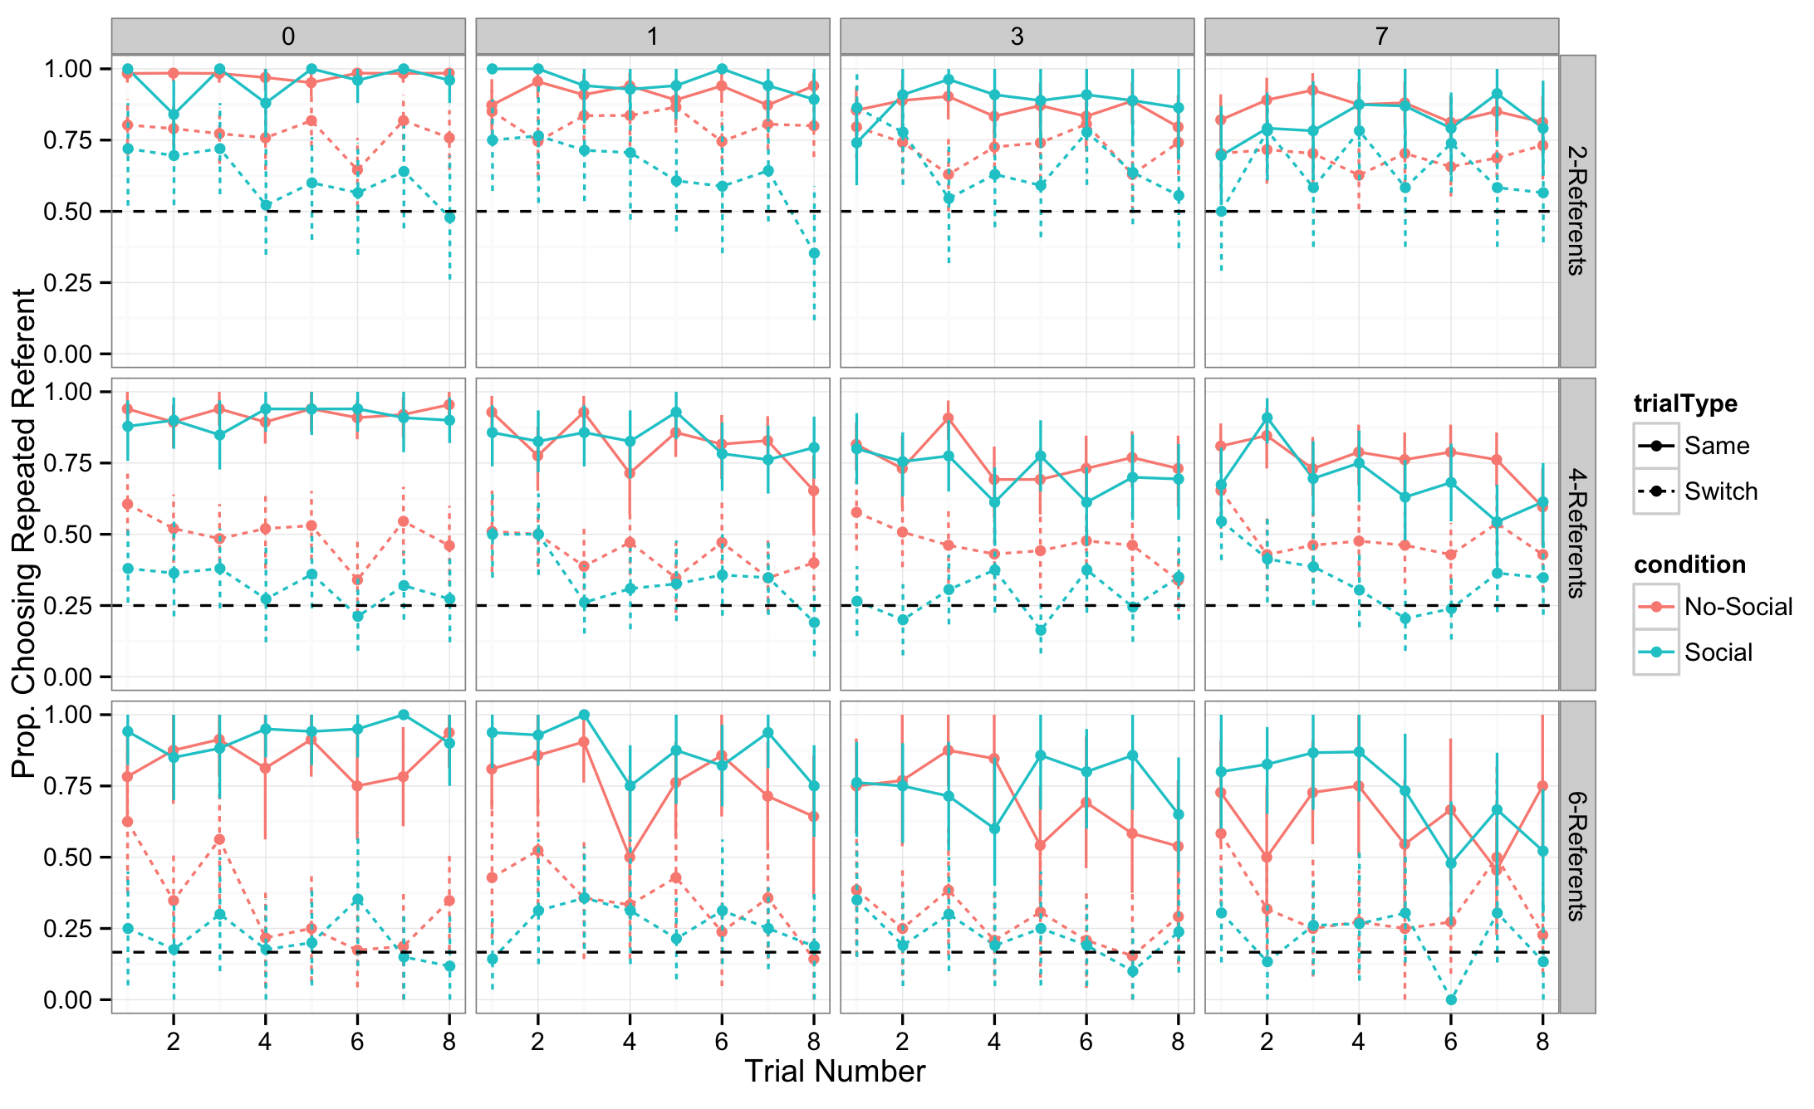
Order Analysis

Slide 49
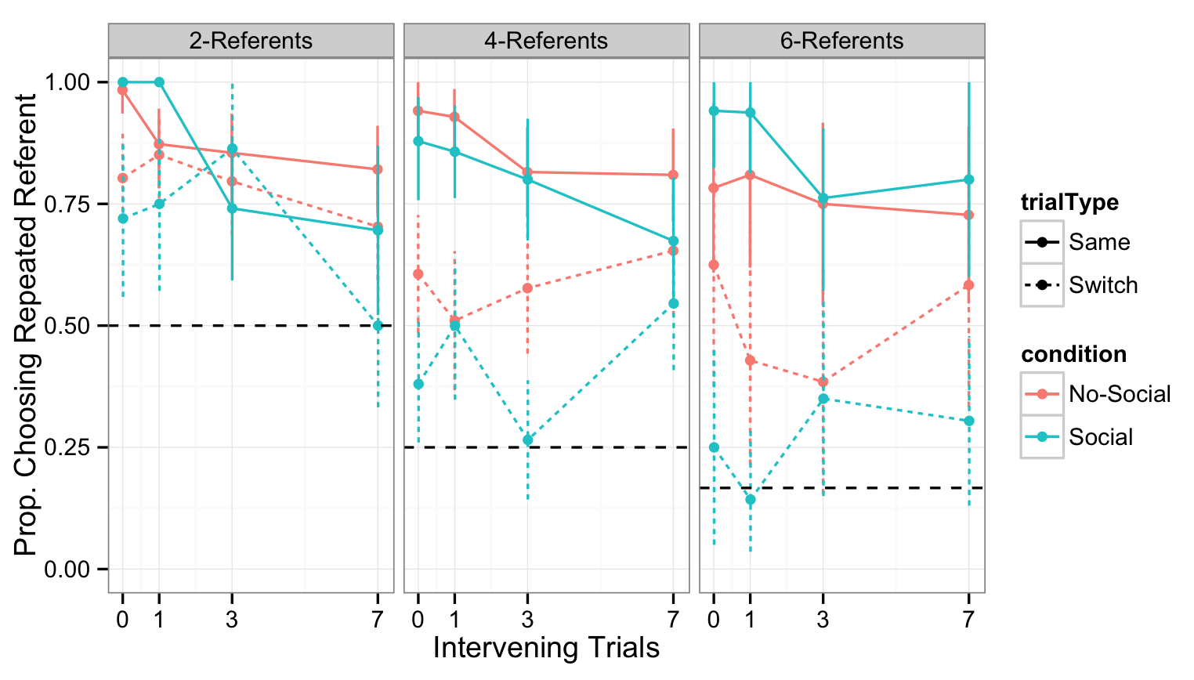
First trial analysis

Slide 50
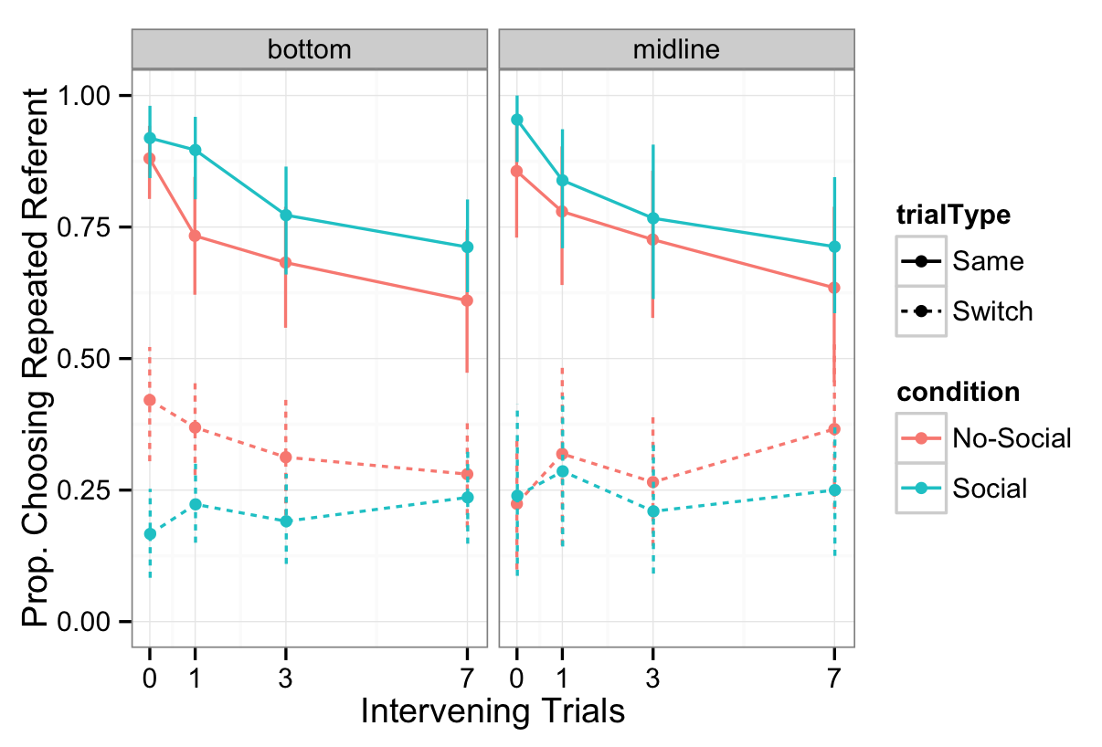
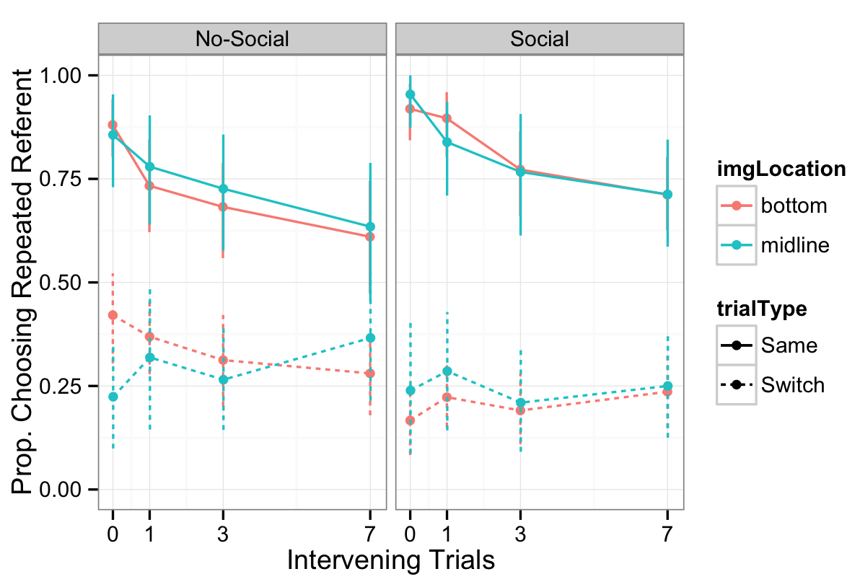
In the 6-referent condition, image location (bottom/midline) does not change the results

Slide 51
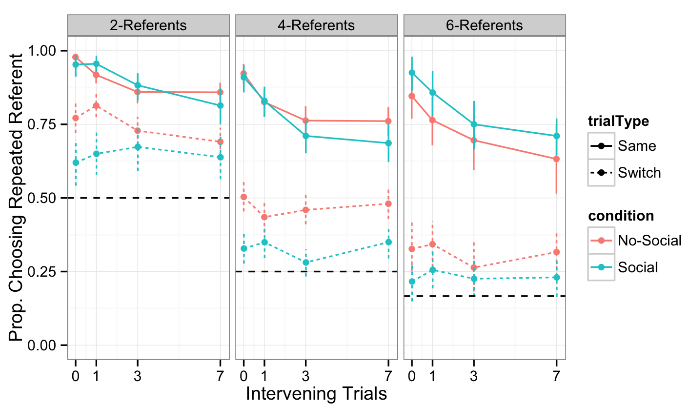
Removing trials on which subjects failed to choose the target of eye gaze does not change results

Slide 52
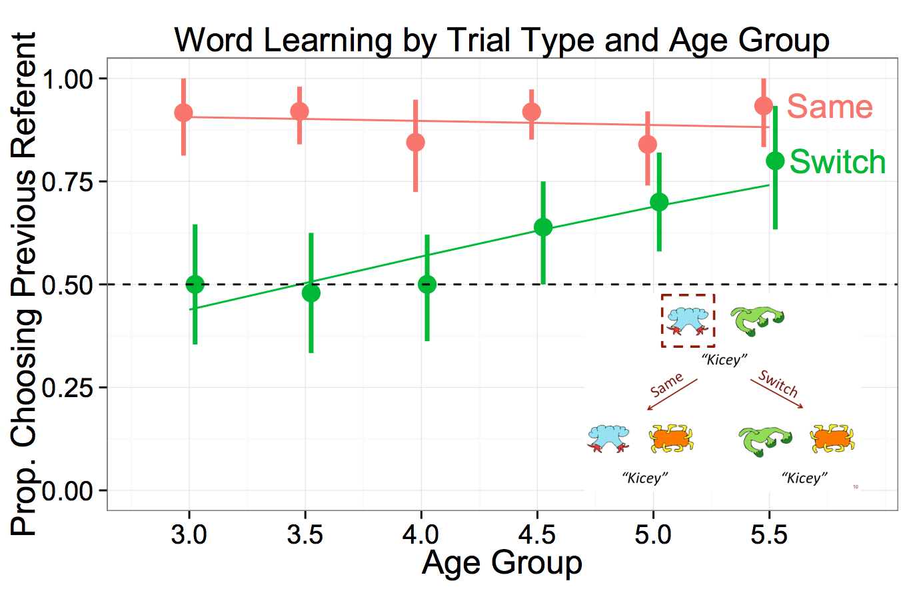
Developmental predictions
Yurovsky & Frank (under review)

Slide 53
Correlational data shows that gaze-following at 10 months predicts faster vocabulary growth
Brooks & Meltzoff (2008)
Notes:
Correlational data show that intention reading skills, as indexed by gaze following ability, predicts faster vocabulary growth.
The thick, solid line represents strong gaze-followers at by the adult ( + 1 SD average duration of
correct looking). The thin, solid line represents the weak gaze-followers (- 1 SD below average). The dashed line is the 50th
percentile of the CDI.
there is sufficient evidence that rich, social interactions are high in information value and facilitate early word-learning. However, these episodes make up only a portion of the word-learning contexts that young children experience, even those growing up in the most supportive of households (Frank, Tenenbaum, & Fernald, 2013). Also, children can learn words from overhead speech and without experiencing much direct social interaction with adults (Shneidman & Goldin-Meadow, 2012).
Can children solve the problem of reference without correlated social cues?

Slide 54
Researchers debate about the underlying processes that support cross-situational word learning
Smith, Suanda & Yu (2014)

Slide 55
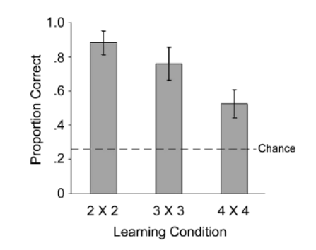
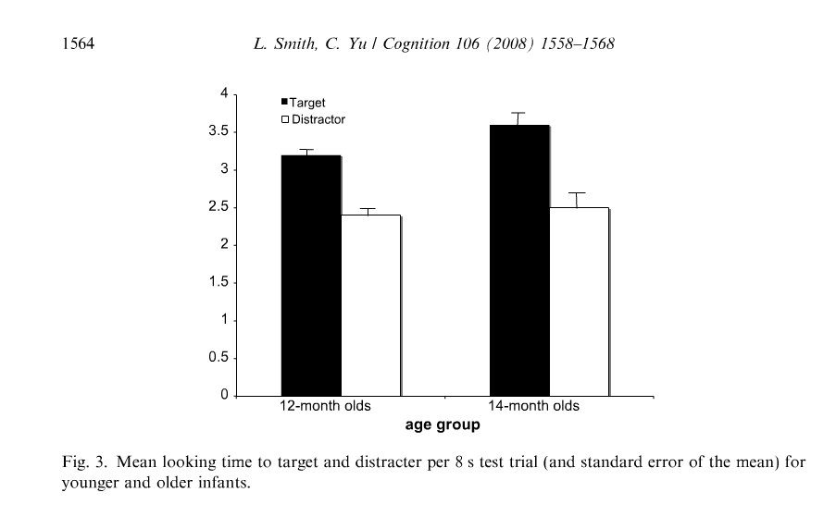
Experimental work shows that both adults and infants can learn novel words from co-occurrence information
2 | 1 |  | 1
 | 1 | 1
Adults
Infants
(Yu & Smith, 2007)
(Smith & Yu, 2008)
Notes:
Adults (Yu & Smith, 2007) and infants (Smith & Yu, 2008) were exposed to small artificial lexica that contained cross-situational regularities across trials. Both groups successfully learned the word– object linkages from this alone, with adults showing evidence of learning even in highly ambiguous conditions. These results provide an important proof of concept, that statistical or associative learning may proceed without solving referential ambiguity in the moment via social cues.
Also, Computational models suggest that XSL can be used to accurately infer the meanings of words from small but realistic corpora of language use (Frank, Goodman, & Tenenbaum, 2009; Siskind, 1996; Yu, 2008; Yu, Ballard, & Aslin, 2005), and other researchers have shown mathematically that XSL can allow large, language-scale lexicons to be learned in the face of considerable referential uncertainty (Blythe, Smith, & Smith, 2010).
So there seems to be strong experimental and correlational work suggesting that social cues facilitate word learning. And there is experimental and modeling work to support the plausibility of cross-situational learning.

Slide 56
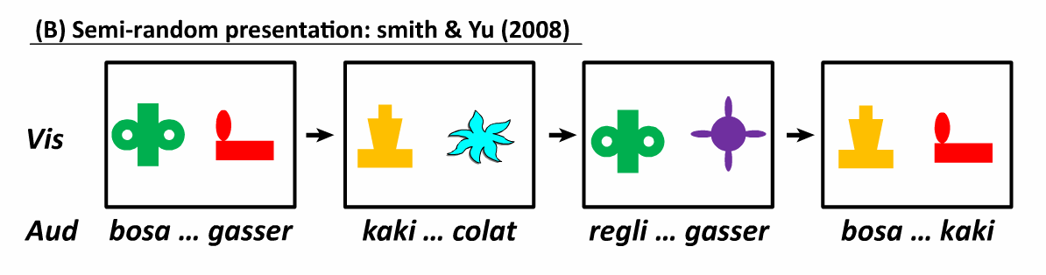



Infants track statistics in the input,
create a co-occurrence matrix, and learn the meaning of “bosa” over time
bosa
regli
kaki
gasser
colat

Slide 57

Same trials
Exposure Trial
Test Trial
Notes:
Focusing on the role of social information during initial exposure to word-object mapping
My experiment is not really xsit learning, but one shot exposure.
So really exploring the role of social cues in the inferences that learners’ make during initial bouts of learning (referent selection)

Slide 58
Switch trials
Exposure Trial
Test Trial
Notes:
Focusing on the role of social information during initial exposure to word-object mapping
My experiment is not really xsit learning, but one shot exposure.
So really exploring the role of social cues in the inferences that learners’ make during initial bouts of learning (referent selection)

